Slide 1
Foreign direct investment and technology spillovers: Evidence from panel data analysis of manufacturing firms in Zambia
Samuel Mulenga Bwalya

Slide 2
Motivation
FDI helps to fund investment projects in the economy
FDI increases the level of technical progress in the host country
Technology transferred to developing countries via FDI tends to be newer than that via licensing
Multinational corporations possess superior intangible assets including technology, managerial skills, export contracts and reputation and good will.
They can transfer their intangible assets to their abroad subsidiaries and spread to local firms through technology spillover effects

Slide 3
Motivation
Productivity spillovers can occur through channels like:
(i) movement of highly trained and skilled staff from foreign firms to domestic firms
(ii) “demonstration effect” in the arm’s length relationships between foreign and domestic firms
(iii) “competition effects”, force rival domestic firms to upgrade production techniques to remain competitive and productive
(iv) adverse competition effects, if foreign firms attract away demand from domestic firms and draw down the productivity of domestic firms

Slide 4
Background
In the 1980s, Zambia embarked on a series of International Monetary Fund (IMF) and World Bank inspired pro-market economic reforms and policies to attract FDI
Zambia offers competitive fiscal and investment incentives to attract and retain foreign investment in the economy
In addition to tax holidays and several other incentives, Zambia offers a 100% repatriation of profits and has the most liberal investment climate in the southern Africa

Slide 5
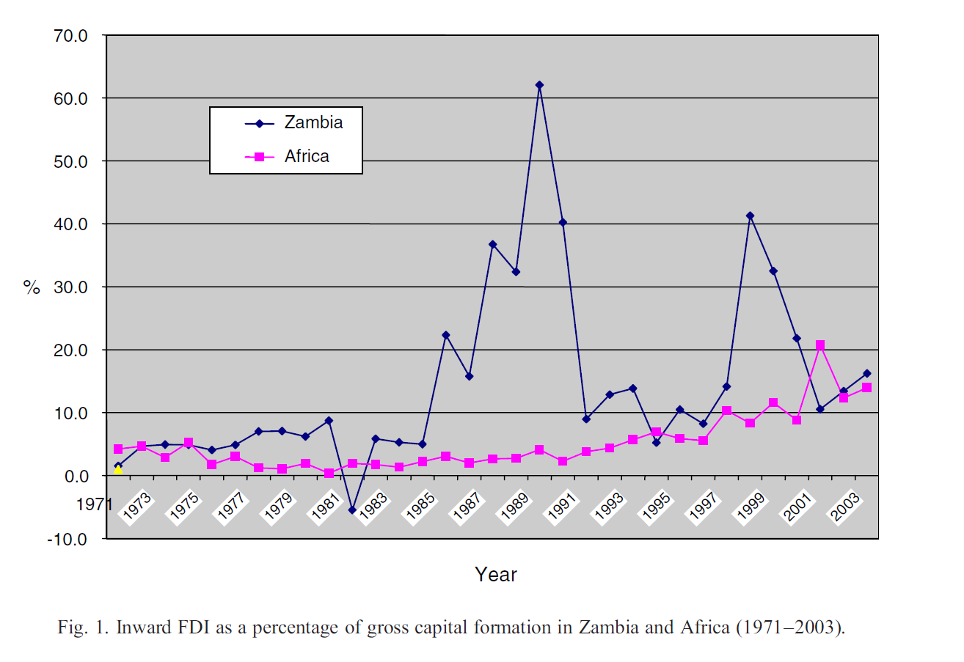

Slide 6
Data
Annual data on Zambian manufacturing firms collected by the World Bank through the Regional Program on Enterprise Development (RPED) survey conducted in 1993, 1994 and 1995
125 firms covers the food, textiles, wood and metal industries
A firm is said to be “foreign” if it has at least 5% foreign shareholding

Slide 7
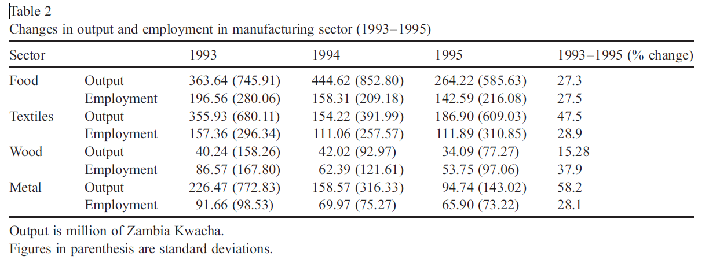
Data

Slide 8
Data
Output and employment declined throughout the survey period which coincides with the implementation of pro-liberal economic and political reforms.
This can be attributed to increased competition from imports following trade liberalization.
Notes:
The ratio of labor employed by foreign firms (or ratio of sales or capital assets) to total labor employed (capita assets or sales) in sector is a proxy measure of technology spillover. Results for the spillover variable using sales or capital stock were not different and are not reported.

Slide 9
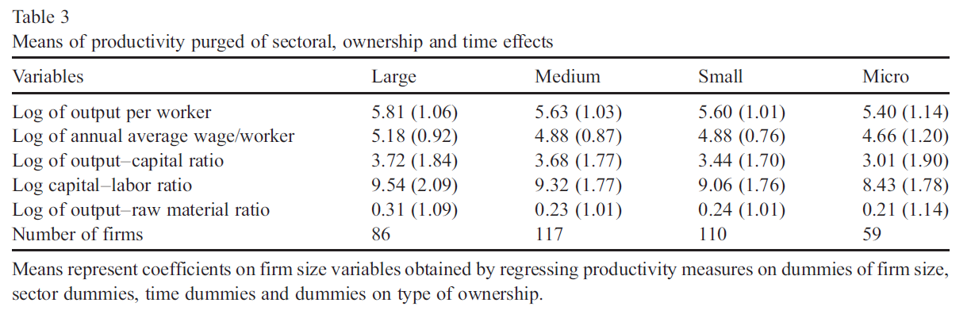
Data

Slide 10
Data
mean productivity decreases as one moves from large to micro-firms
These differences may be an indication of the importance of unobservable factors, such as managerial and organization abilities, quality of the workforce and other intangible firm-specific assets in explaining productivity differences across firms.

Slide 11
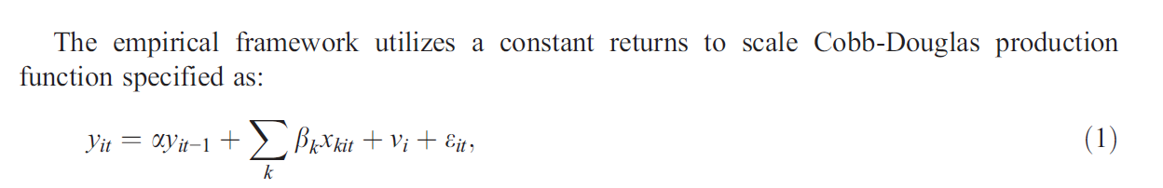
Model

Slide 12
Model
The horizontal spillover variable, FDI_spill, defined as a ratio of labor employed by foreign firms to total labor in the sector captures horizontal (intra-industry) productivity spillovers.
The regional spillover variable, FDI_region, is calculated as a ratio of sales of foreign firms to total sales in the region.
For vertical spillover, FDI_back, was calculated as the proportion of that output, excluding services, produced by downstream sectors and supplied to upstream sectors weighted by the share of foreign employment to total employment in the industry.
Notes:
The ratio of labor employed by foreign firms (or ratio of sales or capital assets) to total labor employed (capita assets or sales) in sector is a proxy measure of technology spillover. Results for the spillover variable using sales or capital stock were not different and are not reported.

Slide 13
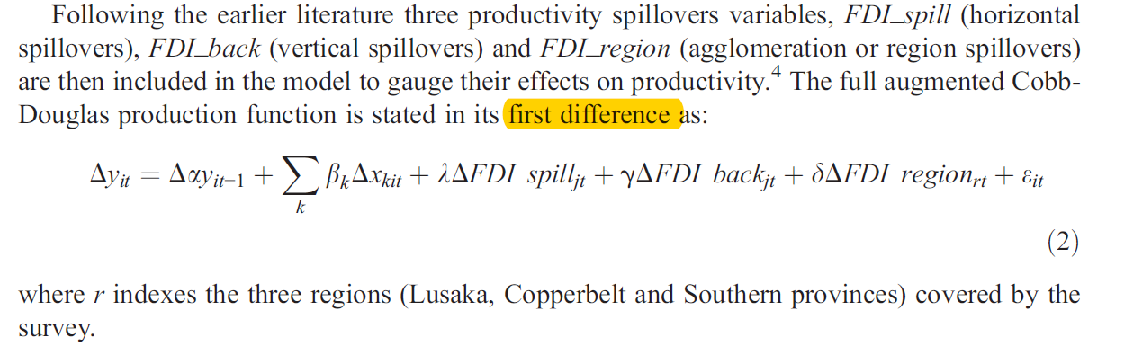
Model

Slide 14
Econometric concerns
Unobservable factors may be correlated to the input choices since it is observable for firm manager but unobservable to the analyst
Most firm-level data is poorly recorded and likely to be measured with errors
Solution:
Permanent unobserved heterogeneity is addressed by differencing the data to remove possible correlation between explanatory variables and firm-specific effects.
Input endogeneity is addressed by adopting an instrumental variable estimation procedure

Slide 15
Econometric concerns – IV procedure
If the random, εit, is non-persistent, a standard generalized method of moments estimator (GMM) will be both consistent and efficient
However, when the dynamic error processes are highly persistent, lagged levels have been shown to be poor instruments for contemporaneous differences and lead to finite sample biases.
Thus, both lagged differences and lagged levels are used as instruments in estimating parameters of the production function, and the resulting system GMM (SYS-GMM) estimator is both consistent and efficient.

Slide 16
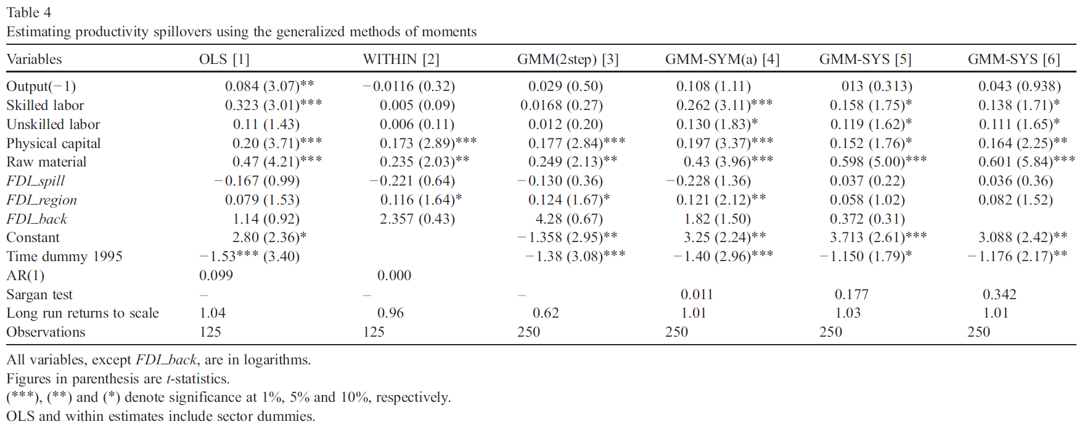
Results

Slide 17
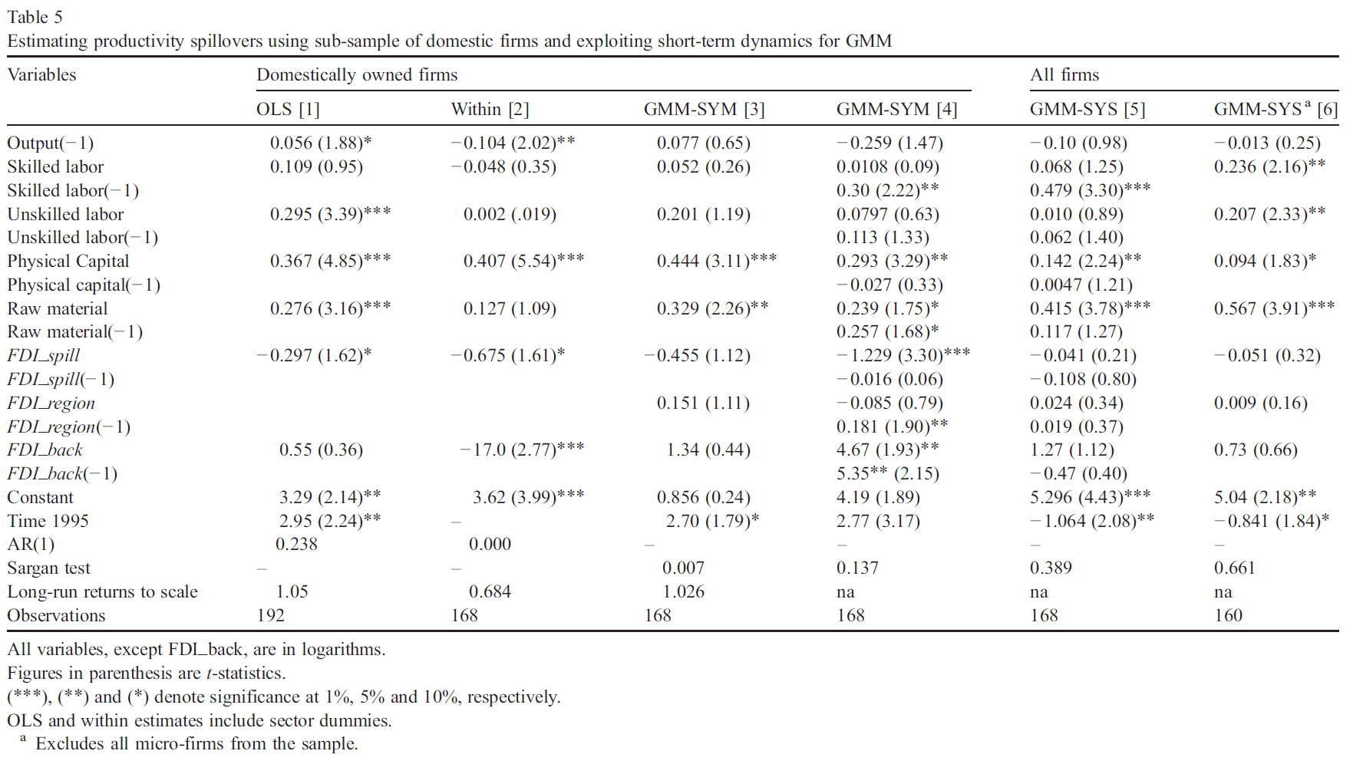
Results

Slide 18
Discussion
The coefficient on FDI_spill (horizontal spillovers) is negative and statistically significant in columns 1, 2 and 4 of Table 5 and only insignificant in column 4, suggesting that FDI substitutes, rather than complements, capital formation and productivity of local firms in the sector.
This result is anticipated because FDI firms seek to consolidate their market share and profits by protecting leakage of technical information to their potential competitors within the sector

Slide 19
Discussion
The coefficients on the inter-industry spillover variable (FDI_back) and its first lag are both positive and significant (Table 5, column 4)
FDI firms may encourage selective and mutually beneficial knowledge spillovers to non-rival firms through backward and forward linkages.

Slide 20
Discussion
The coefficient on regional FDI variable (FDI_region) is positive but statistically insignificant coefficient in Table 4, and its lagged variable is positive and significant in Table 5, column 4.
While competition for market share happens at the national level, technology tends to spillover more rapidly between adjacent firms in regions with a high concentration of foreign firms.

Slide 21
Criticism
Relatively short panel data set which may underestimate the spillover effect that could happen in the long run
The proxies used to estimate spillover effects is highly aggregated in the sector level instead of firm level

